Slide 1

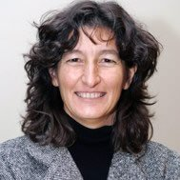




Section for Migrant and Ethnic Minority Health
Our year 2018- 2019
Section Growth
Launch of a newEUPHA MEM Section Strategy
Follow up MERH 2018 – Establishing the Interim Working Committee Global Society
Participation of Section in International Conferences/Events
WHO collaboration – International Summer School Turkey
Section Activities- Preconference Marseille Working Groups
President
Bernadette Kumar
Vice President
Charles Agyemang
Vice President
Maria Luisa Vazquez
www.eupha.org
@EUPHActs
office@eupha.org

Slide 2





Section for Migrant and Ethnic Minority Health
. Achievements: networking/knowledge
European MEMH conference
2004
Rotterdam
150
2008
Malmö
200
2010
Pécs
275
2012
Milan
300
2014
Granada
375
2016
Oslo
400
2018
Edinburgh
732

